Slide 1

Indian kids screentime 2025
Indian Kids Screen Time Dataset (Ages 8–18) – Urban & Rural Insights

Slide 2




About This Data Set
This dataset simulates screen time patterns of 9712 Indian children aged 8 to 18 years, built using real-world trends and scientific studies conducted in India between 2023–2024. It combines urban and rural demographics, reflecting differences in device access, screen habits, and health outcomes.

Slide 3
Basic insides for this graph
1. I have placed children below the age of 10 in the Child Group.
2. Children above the age of 10 have been placed in the Teenage Group.
3. This graph mainly shows which health problems are caused due to more screen time.
4. These problems are seen in 60% to 80% of children in both age groups.

Slide 4
Basic insides for this graph
1. This graph shows which device is used the most.
2. In the Child Group,
the most used devices are:
1st: Laptop
2nd: Smartphone
3. In the Teenage Group,
Smartphone is used by 40% - 60%
TV is the second most used device
4. From this, we understand that teenagers use smartphones more than children.

Slide 5
Basic insides for this graph
1. In this graph, 'Urban' means city and 'Rural' means village.
2. From the pie chart, we can see that:
1)52% of teenagers using screens are from urban areas
2)23% of teenagers are from rural areas
3. In the Child Group:
19% are from urban areas
8% are from rural areas
4. This shows that children from urban (city) areas have the highest screen time.

Slide 6
Basic insides for this graph
1. This graph shows the screen time of devices used daily.
2. In the Child Group,
The average screen time is 4 hours
The maximum screen time is 14 hours
3. In the Teenage Group,
The average screen time is 5 hours
The maximum screen time is 9 hours
4. This graph shows that:
Children have the highest maximum screen time
Teenagers have a higher average screen time

Slide 7
Basic insides for this graph
1. This graph shows how too much use of smartphones and other devices is affecting education.
2. So far, the data shows that 68% of teenagers are facing a negative impact on their education.
3. In the Child Group, 32% of children are affected in the same way.
4. So, overall, the growth of teenagers may be reduced due to high device usage.

Slide 8
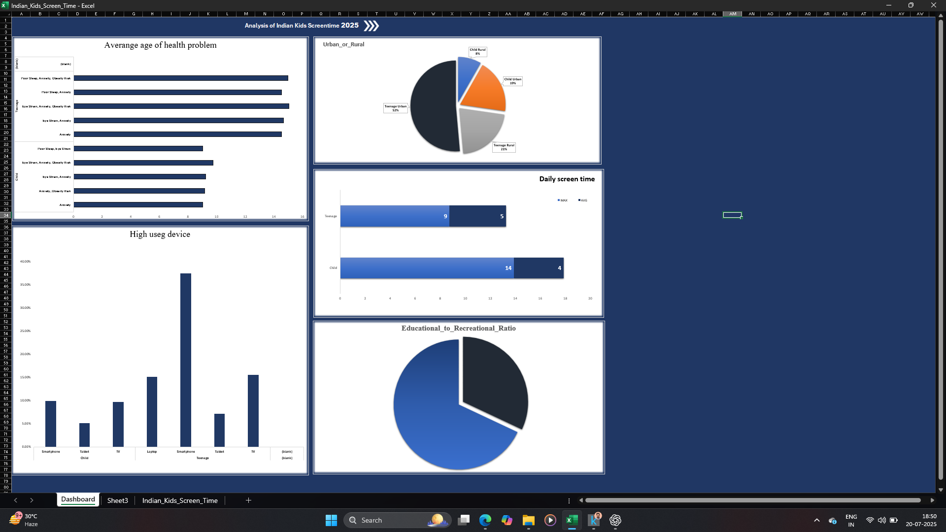

Slide 9




FINAL RESULT
Teenagers have the highest screen time among both groups.
Due to this, their mental and physical health is getting affected by 60% to 80%.
High screen time also reduces focus on education and other activities.
These problems are seen more in children living in urban (city) areas.
|| Based on 2023–2024 data, we can estimate that ||
In 2025, children's screen time will likely increase further.
Focus capacity in children will keep decreasing day by day.
Mental and physical health problems will become more common.
|| This can lead to ||
Irritability
Forgetfulness
Sleep problems
And most importantly, a rise in depression among children.

